Slide 1



NETWORK FORENSIC INVESTIGATION
PCAP Network Packet Capture Analysis
Date: 18/02/2025
Prepared by,
Name : M D P Induwara
VU ID : 8145490
NSBM ID : 30229
Name : T W V Fernando
VU ID : 8145685
NSBM ID : 24982
FINAL PROJECT PRESENTATION

Slide 2

01
Case Overview
TABLE OF CONTENT
02
Summary of findings
03
Assets used in investigation
04
Forensic Tools utilized
05
Investigation methodology steps
06
Step 1 – PCAP File Analysis
07
Step 2 – Filtering & Identifying Evidence
08
Step 3 – Tracing the suspect
09
Step 4 – Correlating Evidence
10
Key Evidences
11
Conclusion and Recommendations

Slide 3

Case Overview
INCIDENT : Harassing emails sent to a teacher
OBJECTIVE : Identify and confirm the sender using forensic analysis
INVESTIGATION SCOPE :
School network traffic
Email Tracing
Endpoint identification

Slide 4

SUSPECT IDENTIFIED – Email linked to a student
TOOLS USED – Wireshark, Network Miner, OSINT techniques
EVIDENCE – PCAP file, Email metadata, MAC address tracking
Summary of Findings
CONCLUSION – Strong Forensic evidence supports disciplinary/ legal action

Slide 5

Assets used in Investigation
Captured PCAP File : Network Traffic logs
School Network Logs : DNS queries, email headers
Device Information : Identifying MAC/IP addresses
Legal Documentation : Chain-of-custody and compliance

Slide 6

Wireshark
Forensic Tools Utilized
Analyzing network packets
Network Minor
Extracting host information
Email tracing Tools
Identifying anonymous email sources
Hex editors & log analysis Tools
Deep packet inspection

Slide 7

Investigation Methodology
Step 01
Step 02
Load PCAP File and examine traffics
Filter email and DNS queries
Step 03
Step 04
Identify MAC & IP addresses related to the suspect
Correlate network behavior with email timestamps

Slide 8
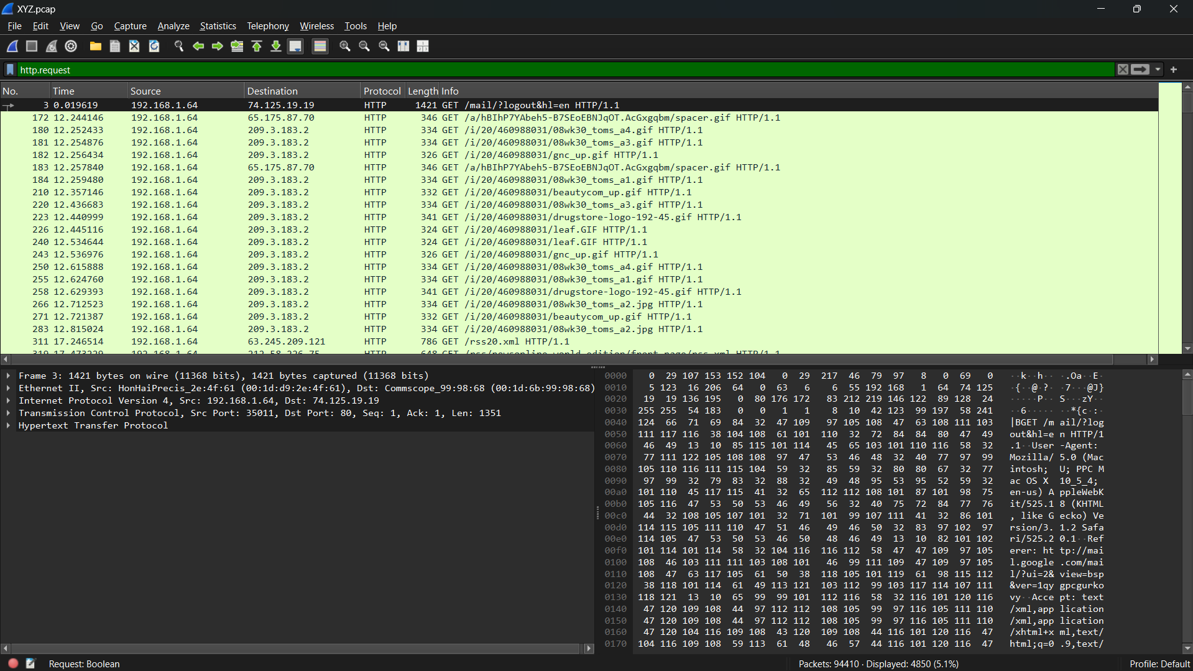
Step 1 – PCAP File Analysis
The PCAP file, containing network traffic, can be analyzed using Wireshark to identify suspicious activity, such as email exchanges and DNS lookups, and pinpoint potential sources of harassment.
Opening PCAP file in Wireshark

Slide 9
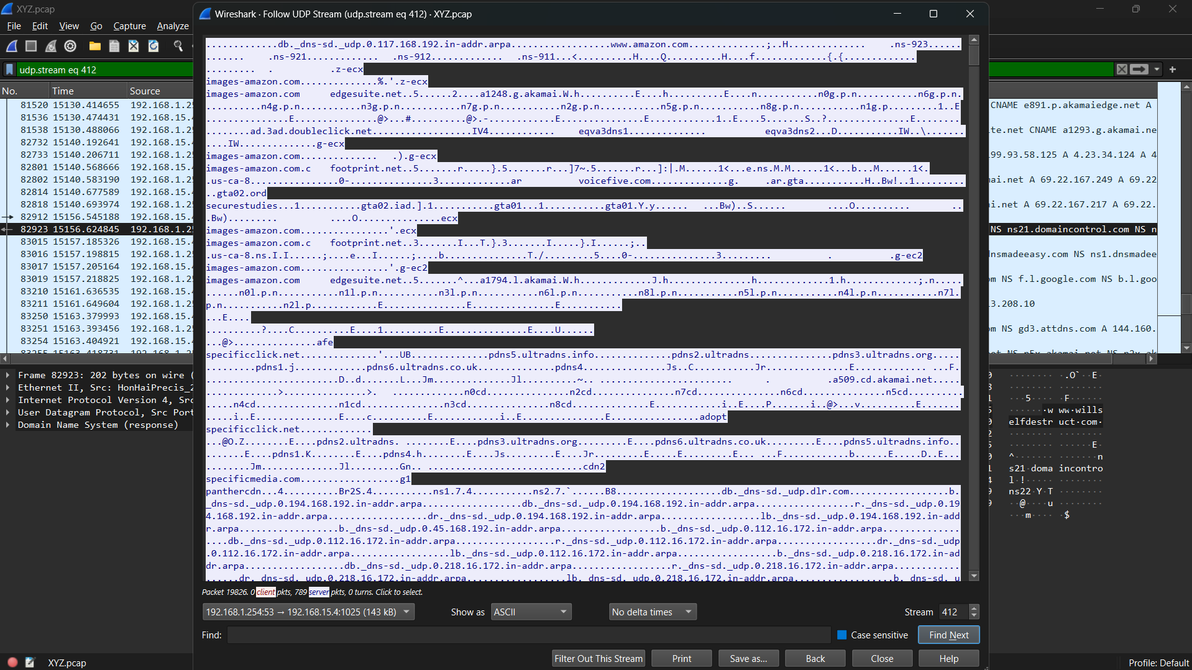
Step 2 – Filtering & Identifying Evidence
Wireshark filters isolate network traffic, like email headers and DNS queries, to focus on suspect device interactions and identify specific harassment-related messages.
Filtering traffic to locate email-related activities

Slide 10
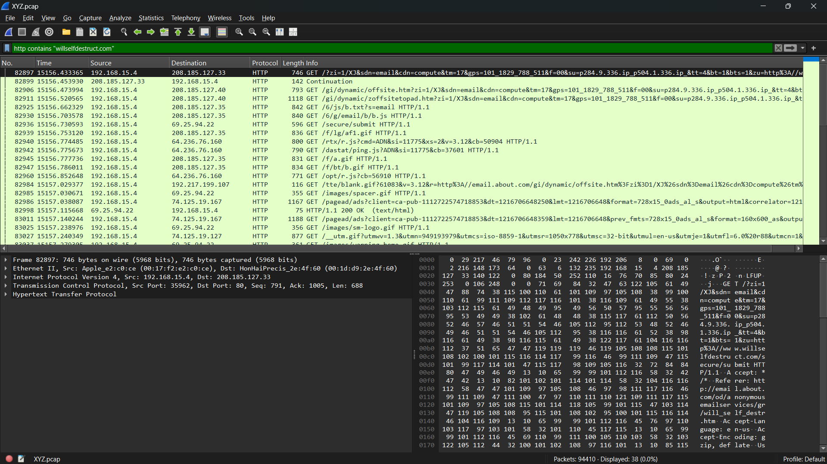
Step 3 – Tracing the suspect
The PCAP files MAC and IP addresses can be linked to school network logs to identify the device used for harassing emails, bolstering the suspect’s case.
MAC & IP tracking

Slide 11
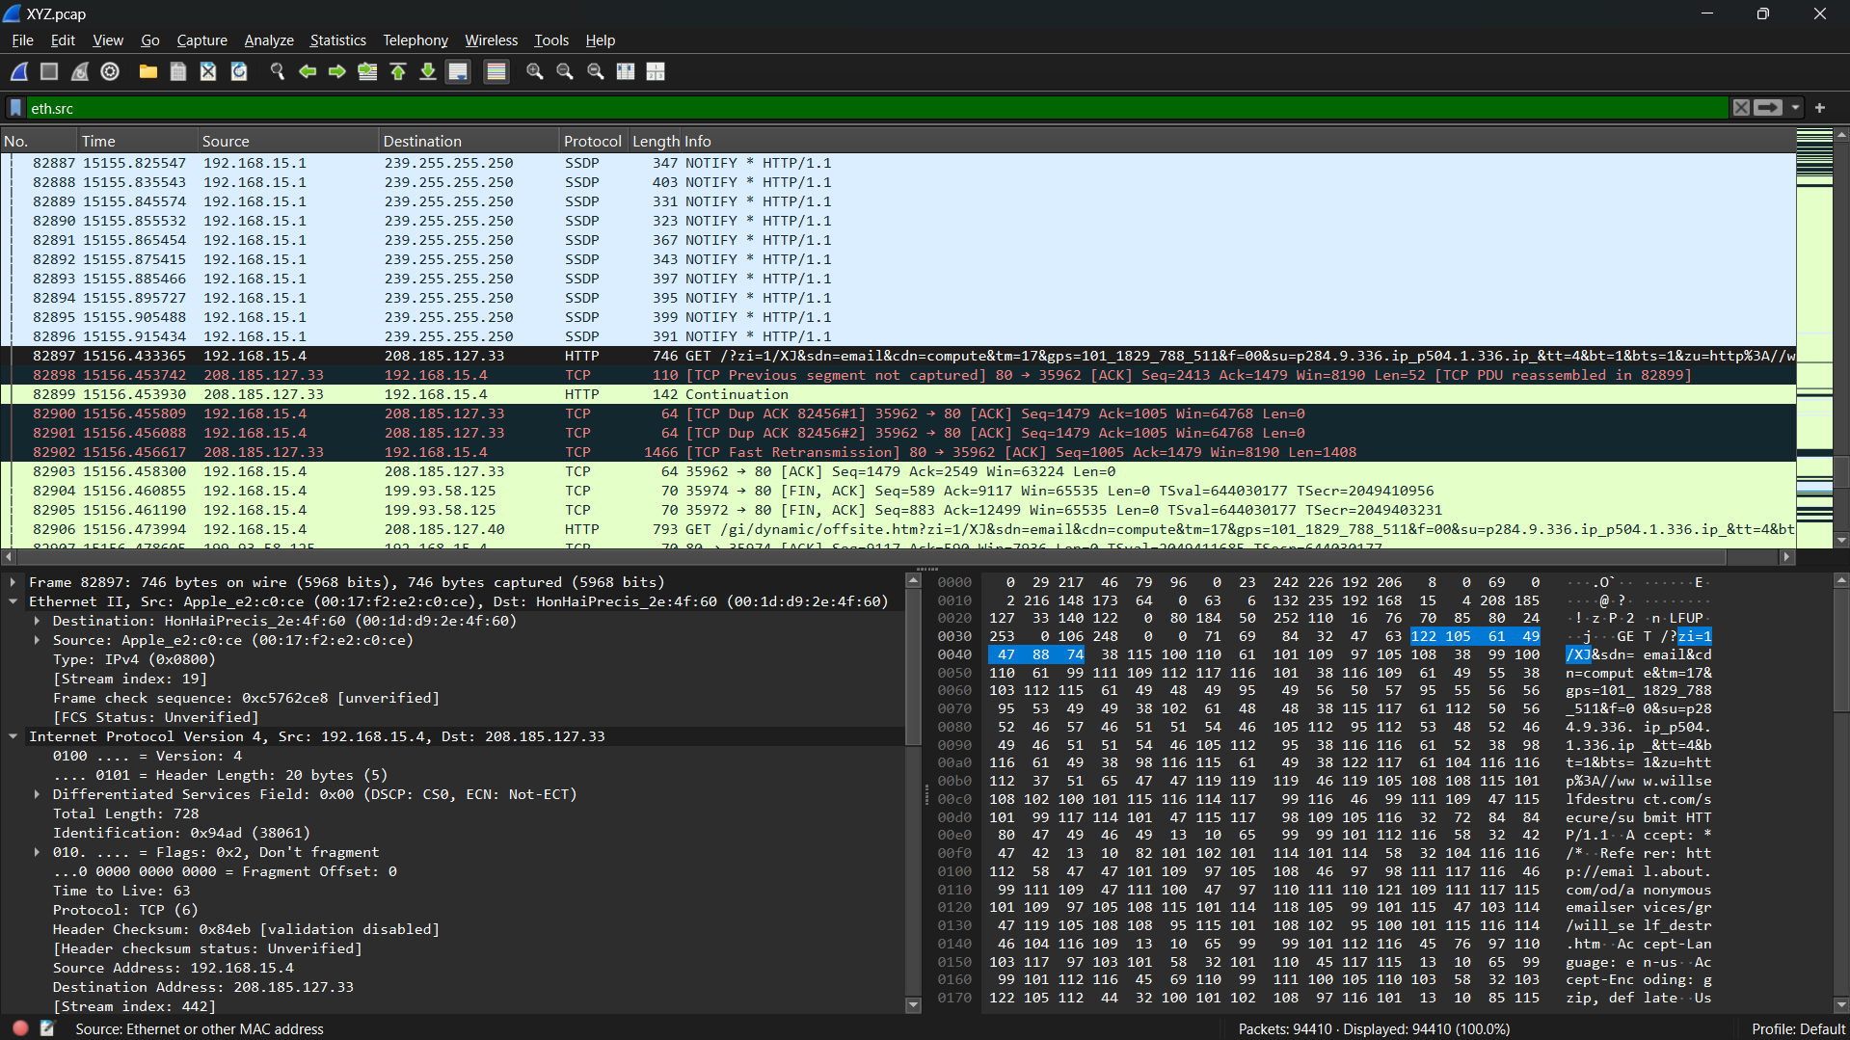
Step 4 – Correlating Evidence
Analyzing timestamps, search history and email metadata creates a network activity timeline to confirm the suspect’s involvement in the harassment and verify their device’s responsibility for sending emails.
Email headers and search queries

Slide 12


Key Evidence supporting the Case
Email Source Identified : Anonymous mail service logs
Search history : “Can I go to jail for harassing my teacher?”
MAC Address Linkage: Matches suspect’s device
Legal Compliance : Ensuring evidence integrity

Slide 13
Conclusion
Final Verdict: Digital footprint confirms suspect’s involvement.
Cybersecurity lessons: Importance of forensic tools in cyber investigations.
Recommendations
Actionable Steps: School authorities to take disciplinary/legal actions.
Preventive Measures: Strengthening network security policies.
Monitoring Solutions: Implementing real- time network traffic analysis.

Slide 14
THANK YOU…

